Slide 1
Provider of Global Contract Research Services Accelerating Preclinical Research, Drug Discovery & Therapeutics
Services > In Vivo Xenograft Services
U-87 LUC Xenograft Model
The U-87 LUC cell line is a luciferase-expressing U-87 epithelial cell line, obtained from a 44-year-old Caucasian female patient with Stage 3 glioblastoma. Human tumor xenograft animal models may lead to breakthroughs in brain cancer research and innovative treatment approaches that are essential for glioblastoma patients.
U87-LUC cells represent a human glioblastoma cell line, which is used to create subcutaneous and metastatic xenograft brain cancer mouse model U87-LUC, a highly utilized CDX for studying angiogenesis and anti-angiogenic therapeutic agents.
Xenografting is the transplantation of tissue from one species into another.
Xenografting has been established as benchmark studies in pre-clinical cancer research.
Typically, immunodeficient mice serve as hosts for a wide variety of human tumors, effectively serving as models for human subjects.
Xenografting is a complete and accurate study of tumor growth and the activity of drug administration.
Xenografting tumor cells into mice has advanced pre-clinical cancer research significantly
Altogen Labs • 11200 Manchaca Road #203 • Austin • TX • 78748 • USA
Telephone • 512 433 6177 • email • info@altogenlabs.com

Slide 2
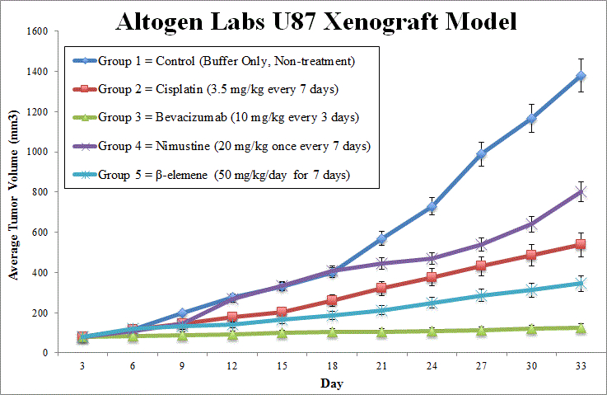
Provider of Global Contract Research Services Accelerating Preclinical Research, Drug Discovery & Therapeutics
Services > In Vivo Xenograft Services
U-87 LUC (Glioblastoma) Xenograft Study
Data Endpoints
Estimated tumor volume (L x W² /2)
Mean/median time to specified tumor volume
Survival time to specified tumor volume
Tumor doubling time
Tumor growth inhibition (TGI)
Tumor growth delay (TGD)
Increased life span (ILS)
Tumor cell kill rate
Altogen Labs • 11200 Manchaca Road #203 • Austin • TX • 78748 • USA
Telephone • 512 433 6177 • email • info@altogenlabs.com

Slide 3
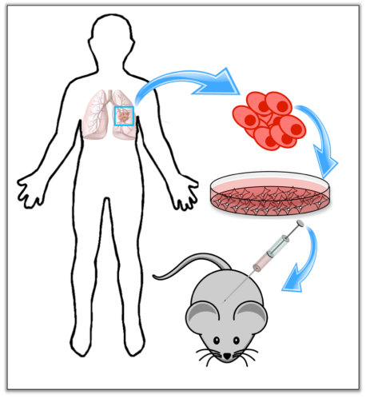
Provider of Global Contract Research Services Accelerating Preclinical Research, Drug Discovery & Therapeutics
Services > In Vivo Xenograft Services
U-87 LUC Xenograft Model
Advantages of Xenografting
Develop new therapeutic agents quickly, efficiently and cost-effectively
Evaluate the efficacy and toxicity of potential therapeutic agents
Evaluate target compound activity using in vivo system (human cells)
Predict cytotoxicity of cancer drugs
Xenotransplantation is the transplantation of living cells, tissues or organs from one species to another.
Altogen Labs • 11200 Manchaca Road #203 • Austin • TX • 78748 • USA
Telephone • 512 433 6177 • email • info@altogenlabs.com

Slide 4
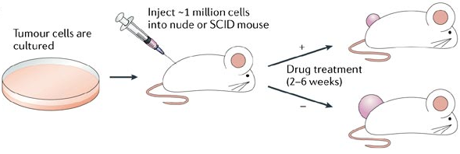
Provider of Global Contract Research Services Accelerating Preclinical Research, Drug Discovery & Therapeutics
Services > In Vivo Xenograft Services
U-87 LUC Xenograft Model
Basic Xenograft Study
Xenograft studies can be designed to:
Identify lead compounds
Optimize dose schedules
Identify combination strategies
Altogen Labs • 11200 Manchaca Road #203 • Austin • TX • 78748 • USA
Telephone • 512 433 6177 • email • info@altogenlabs.com

Slide 5
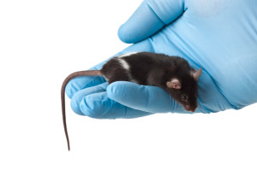
Provider of Global Contract Research Services Accelerating Preclinical Research, Drug Discovery & Therapeutics
Services > In Vivo Xenograft Services
U-87 LUC Xenograft Model
Routes of drug administration:
Intratumoral
Intramuscular
Oral gavage
Intravenous
Intratracheal
Subcutaneous
Intraperitoneal
Continuous infusion
Intranasal
Using cutting-edge micro-injection techniques
Several routes of drug administration can be explored in a Xenograft model
www.patient-derived-xenograft-services.com
Altogen Labs • 11200 Manchaca Road #203 • Austin • TX • 78748 • USA
Telephone • 512 433 6177 • email • info@altogenlabs.com

Slide 6
Provider of Global Contract Research Services Accelerating Preclinical Research, Drug Discovery & Therapeutics
Services > In Vivo Xenograft Services
U-87 LUC Xenograft Model
Following options are available for the U-87 LUC xenograft model:
U-87 LUC Tumor Growth Delay (TGD; latency)
U-87 LUC Tumor Growth Inhibition (TGI)
Dosing frequency and duration of dose administration
U-87 LUC tumor immunohistochemistry
Alternative cell engraftment sites (orthotopic transplantation, tail vein injection and left ventricular injection for metastasis studies, injection into the mammary fat pad, intraperitoneal injection)
Blood chemistry analysis
Toxicity and survival (optional: performing a broad health observation program)
Gross necropsies and histopathology
Positive control group employing cyclophosphamide, at a dosage of 50 mg/kg administered by intramuscular injection to the control group daily for the study duration
Lipid distribution and metabolic assays
Imaging studies: Fluorescence-based whole body imaging, MRI
Altogen Labs • 11200 Manchaca Road #203 • Austin • TX • 78748 • USA
Telephone • 512 433 6177 • email • info@altogenlabs.com

Slide 7
Provider of Global Contract Research Services Accelerating Preclinical Research, Drug Discovery & Therapeutics
Services > In Vivo Xenograft Services
U-87 LUC Xenograft Model
Altogen Labs’ team of scientists carries extensive experience in Xenograft model research.
Altogen Labs is compliant as a Good Laboratory Practices (GLP) environment, which is required by the FDA for pre-clinical research.
Our Altogen Labs’ Xenograft services are extensive, rigorous, and flexible.
Altogen Labs can partner with you for any Xenograft research project.
Photo credit: wisegeek.com
Contact us to discuss Xenograft model details, timeline estimates, and price quotes!
Altogen Labs • 11200 Manchaca Road #203 • Austin • TX • 78748 • USA
Telephone • 512 433 6177 • email • info@altogenlabs.com

