Slide 1
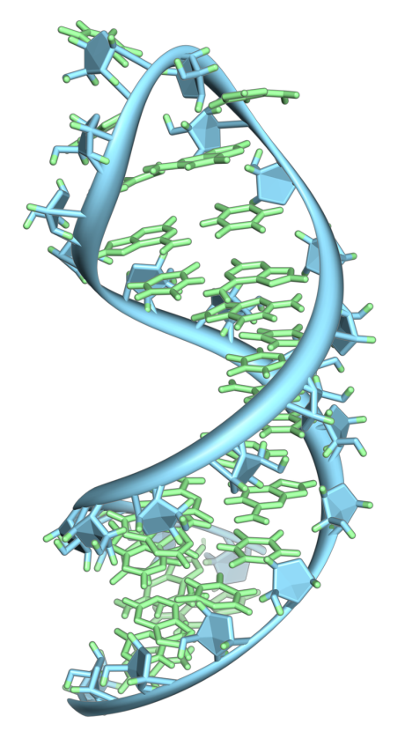
Provider of Global Contract Research Services Accelerating Preclinical Research, Drug Discovery & Therapeutics
Services > Quantitation of siRNA Knockdown
RNA Interference
Practical method of immense potential for regulating gene expression
Harnessing a natural cellular process
dsRNA introduced to the cell
Cleaved and processed by Dicer
Incorporated into RNA-Induced Silencing Complex (RISC)
Target gene silenced by endonuclease activity of argonaute2
By Vossman - Own work, CC BY-SA 3.0, https://commons.wikimedia.org/w/index.php?curid=7115139
Altogen Labs • 11200 Manchaca Road #203 • Austin • TX • 78748 • USA
Telephone • 512 433 6177 • email • info@altogenlabs.com

Slide 2
Provider of Global Contract Research Services Accelerating Preclinical Research, Drug Discovery & Therapeutics
Services > Quantitation of siRNA Knockdown
Introduction of dsRNA into the cell triggers cleavage by Dicer to yield siRNAs
RISC binds to, processes, incorporates siRNA
RISC uses siRNA to seek out complementary sequences and degraded them – silencing gene expression
http://zimdarsgen564s14.weebly.com/rna-interference.html
Altogen Labs • 11200 Manchaca Road #203 • Austin • TX • 78748 • USA
Telephone • 512 433 6177 • email • info@altogenlabs.com

Slide 3
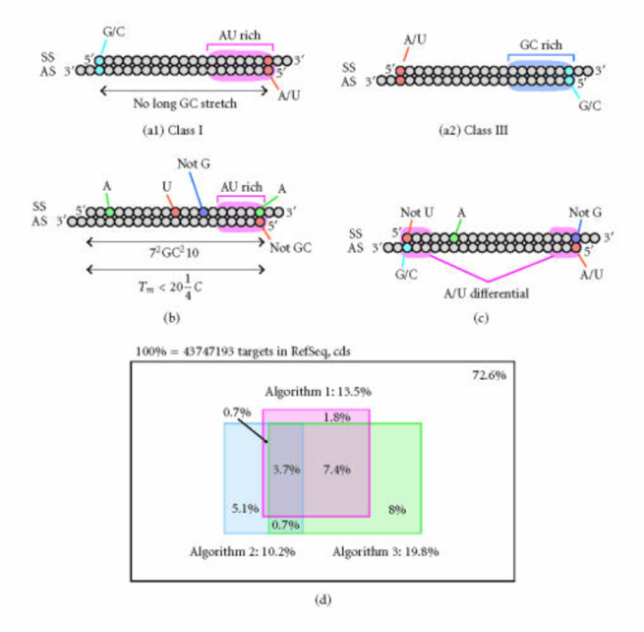
Provider of Global Contract Research Services Accelerating Preclinical Research, Drug Discovery & Therapeutics
Services > Quantitation of siRNA Knockdown
RNAi Sequence Prediction
There are several algorithms presented to be effective predictors of ribonucleotide sequences that can effectively knockdown target genes
However, empirical data demonstrates that less than 30% of these predicted sequences achieve a high level of gene silencing in practice (>80% knockdown of target mRNA)
The transfection of different cell lines will have an influence on these results as well
Rational RNAi Design
Journal of Biomedicine and Biotechnology 2006 (2006): 65052
Altogen Labs • 11200 Manchaca Road #203 • Austin • TX • 78748 • USA
Telephone • 512 433 6177 • email • info@altogenlabs.com

Slide 4
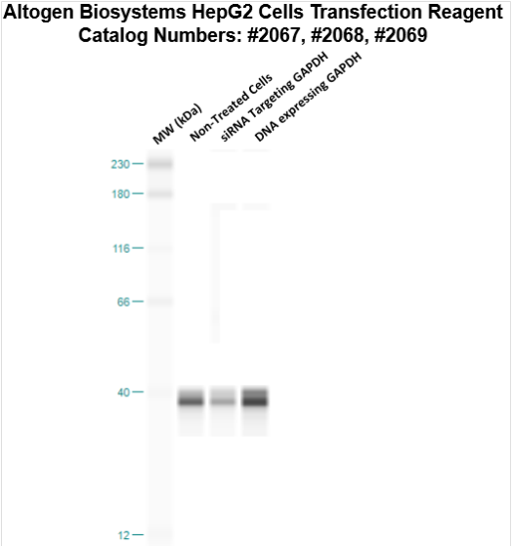
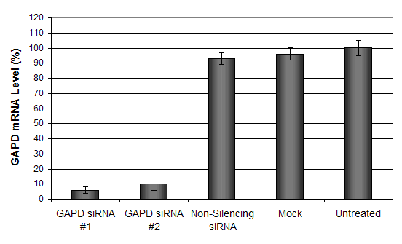
Provider of Global Contract Research Services Accelerating Preclinical Research, Drug Discovery & Therapeutics
Services > Quantitation of siRNA Knockdown
RNAi Gene Silencing Services
Altogen Labs provides complete RNAi gene silencing services including:
Design
siRNA /shRNA synthesis
Gene knockdown validation
Quantification of reduction in mRNA and protein
HepG2 cells transfected with siRNA targeting Glyceraldehyde-3-Phosphate Dehydrogenase
Post-transfection data displaying targeted knockdown of GAPD mRNA (RT-PCR, top) and protein expression (right)
Altogen Labs • 11200 Manchaca Road #203 • Austin • TX • 78748 • USA
Telephone • 512 433 6177 • email • info@altogenlabs.com

Slide 5
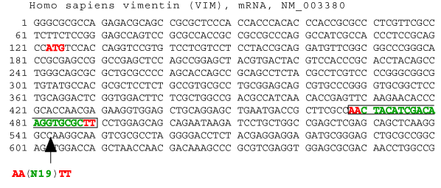
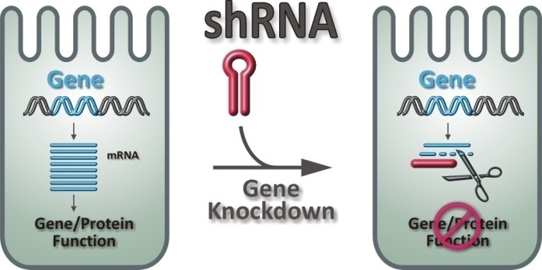
Provider of Global Contract Research Services Accelerating Preclinical Research, Drug Discovery & Therapeutics
Services > Quantitation of siRNA Knockdown
RNAi Gene Silencing Services Deliverables
The client only has to provide the gene name and accession number of the target gene
Altogen Labs designs, synthesizes, HPLC Purifies, and anneals 5 different siRNA molecules targeting the gene of interest
2 of the 5 siRNA sequences are identified as the best silencers
We guarantee that these sequences empirically demonstrate at least 80% reduction in mRNA
Only provided the Gene ID, Altogen Labs can design and execute the knockdown experiments
rnaiweb.com
medicine.dal.ca/research/enhanced-gene-analysis/RNAiOverview.html
Altogen Labs • 11200 Manchaca Road #203 • Austin • TX • 78748 • USA
Telephone • 512 433 6177 • email • info@altogenlabs.com

Slide 6
Provider of Global Contract Research Services Accelerating Preclinical Research, Drug Discovery & Therapeutics
Services > Quantitation of siRNA Knockdown
RNAi Gene Silencing Services
We have over 150 in-house cell lines available for RNAi experiments
Disease / Tumor Type | Cell Line / ID
Breast Adenocarcinoma | SKBR3 (HTB30), MDA-MB (HTB26), MCF7 (HTB22)
Colon Carcinoma | Caco2 (HTB37), LS174T (CL188), SW480 (CCL228)
Kidney | MDCK (CCL34), Cos7 (CRL1651), HEK293 (CRL1573)
Neuroblastoma | SK-N-SH (HTB-11), Neuro-2a (CCL-131)
Prostate Carcinoma | LNCaP (CRL-1740), DU145 (HTB-81)
Leukemia | K-562 (CCL-243), CCRF-CEM (CCL-119)
Pancreatic Carcinoma | Capan-1 (HTB-79), MIA PaCa-2 (CRL-1420)
Melanoma | J774A.1 (TIB-67), SK-MEL-28 (HTB-72)
MCF-7 cells
LNCap cells
J774.1 cells
K562 Cells
Altogen Labs • 11200 Manchaca Road #203 • Austin • TX • 78748 • USA
Telephone • 512 433 6177 • email • info@altogenlabs.com

Slide 7
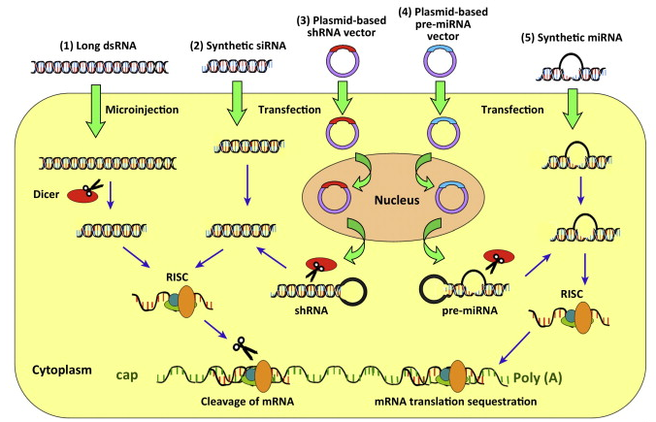
Provider of Global Contract Research Services Accelerating Preclinical Research, Drug Discovery & Therapeutics
Services > Quantitation of siRNA Knockdown
RNAi Gene Silencing Services Deliverables
An additional service offered is to perform the knockdown experiments in a cell line provided by the client
With the gene ID information and the client provided cell line, Altogen Labs will design, construct, and clone shRNA into commercially available vectors, design qPCR primers and transfect the client provided cell line.
Gene expression anlysis is performed by qPCR at 24, 48, and 72 hr intervals
With a client provided gene ID and cell line, Altogen Labs can
design and perform cell-based RNAi gene knockdown
Altogen Labs • 11200 Manchaca Road #203 • Austin • TX • 78748 • USA
Telephone • 512 433 6177 • email • info@altogenlabs.com

Slide 8
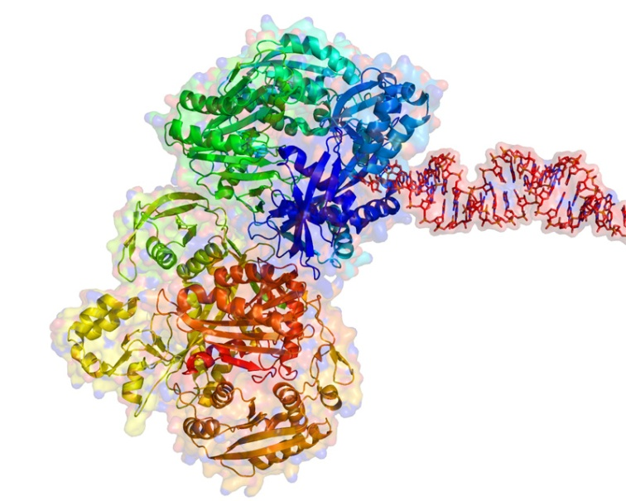
Provider of Global Contract Research Services Accelerating Preclinical Research, Drug Discovery & Therapeutics
Services > Quantitation of siRNA Knockdown
Altogen Labs RNA Interference Services
Starting with the gene ID, our experienced staff designs, synthesizes, anneals, and identifies the best siRNA sequence that quantifiably knocks down gene expression by at least 80%
RNAi knockdown experiments can performed utilizing one of our in-house cell lines or a client provided cell line
RISC complex and RNA
http://helicase.pbworks.com/w/page/17605619/Emily-Devol
Contact us to discuss details, timeline estimates, and price quotes!
Altogen Labs • 11200 Manchaca Road #203 • Austin • TX • 78748 • USA
Telephone • 512 433 6177 • email • info@altogenlabs.com

