Slide 1
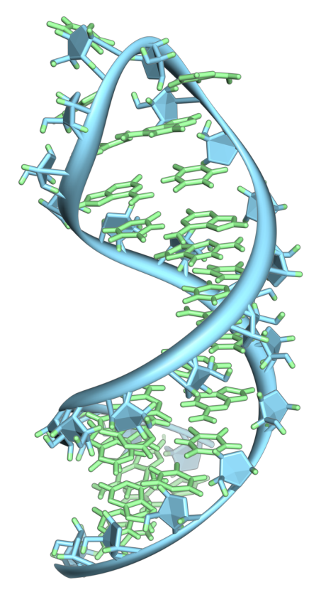
Provider of Global Contract Research Services Accelerating Preclinical Research, Drug Discovery & Therapeutics
Services > RNAi Screening and Analysis
RNA Interference
Practical method of immense potential for regulating gene expression
Harnessing a natural cellular process
dsRNA introduced to the cell
Cleaved and processed by Dicer
Incorporated into RNA-Induced Silencing Complex (RISC)
Target gene silenced by endonuclease activity of argonaute2
By Vossman - Own work, CC BY-SA 3.0, https://commons.wikimedia.org/w/index.php?curid=7115139
Altogen Labs • 11200 Manchaca Road #203 • Austin • TX • 78748 • USA
Telephone • 512 433 6177 • email • info@altogenlabs.com

Slide 2
Provider of Global Contract Research Services Accelerating Preclinical Research, Drug Discovery & Therapeutics
Services > RNAi Screening and Analysis
Introduction of dsRNA into the cell triggers cleavage by Dicer to yield siRNAs
RISC binds to, processes, incorporates siRNA
RISC uses siRNA to seek out complementary sequences and degraded them – silencing gene expression
http://zimdarsgen564s14.weebly.com/rna-interference.html
Altogen Labs • 11200 Manchaca Road #203 • Austin • TX • 78748 • USA
Telephone • 512 433 6177 • email • info@altogenlabs.com

Slide 3
Provider of Global Contract Research Services Accelerating Preclinical Research, Drug Discovery & Therapeutics
Services > RNAi Screening and Analysis
RNAi Screening
RNAi screening enables the identification of novel genes and their cellular functions, as well as new insights into cellular signaling pathways
This provides cellular level result of what phenotype is exhibited by a certain knockdown
siRNA screening has been established as a powerful tool for pre-clinical research
Nature Reviews Genetics 7, 373-384 (May 2006)
Altogen Labs • 11200 Manchaca Road #203 • Austin • TX • 78748 • USA
Telephone • 512 433 6177 • email • info@altogenlabs.com

Slide 4
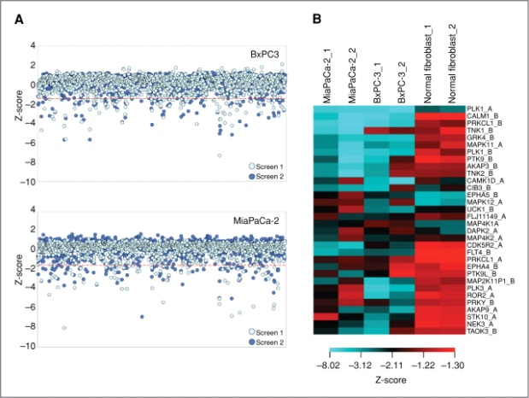
Provider of Global Contract Research Services Accelerating Preclinical Research, Drug Discovery & Therapeutics
Services > RNAi Screening and Analysis
RNAi Screening and Sequence Space
There are over 30,000 genes in the human genome
The theoretical sequence space of only a 20 nucleotide RNA sequence is on the order of 10¹² sequences
Practically speaking, rational design should be employed to narrow an RNAi library for screening to thousands of sequences
To leverage the full potential of this method a robust screening and data processing system must be in place
Statistical Analysis from an RNAi Screen
Mol Cancer Res June 1 2011 (9) (6) 724-732
Altogen Labs • 11200 Manchaca Road #203 • Austin • TX • 78748 • USA
Telephone • 512 433 6177 • email • info@altogenlabs.com

Slide 5
Provider of Global Contract Research Services Accelerating Preclinical Research, Drug Discovery & Therapeutics
Services > RNAi Screening and Analysis
RNAi Library Screening Services
Altogen Labs offers a number of siRNA and microRNA libraries both genome wide and pathway specific
High-throughput library screening
Data analysis
Pathway mapping
Identification of relevant genes and gene associations
Genome wide RNA Screen
http://ribosomebiogenesis.org/rnai-libraries-and-plate-layout.html
Altogen Labs • 11200 Manchaca Road #203 • Austin • TX • 78748 • USA
Telephone • 512 433 6177 • email • info@altogenlabs.com

Slide 6
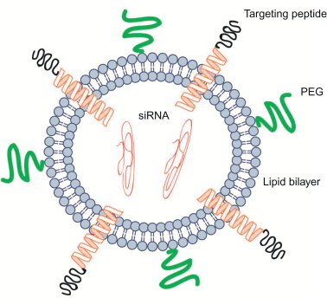
Provider of Global Contract Research Services Accelerating Preclinical Research, Drug Discovery & Therapeutics
Services > RNAi Screening and Analysis
Altogen Labs RNA Interference Services
Our siRNA screening services can be further investigated with our other siRNA services to round out your research project:
siRNA Liposome Encapsulation
Quantification of siRNA Knockdown
Tet-inducible RNAi stable cell lines
Liposomes greatly enhance delivery of siRNA and downstream gene knockdown
http://www.sciencedirect.com/topics/page/Stable_nucleic_acid_lipid_particle
Altogen Labs • 11200 Manchaca Road #203 • Austin • TX • 78748 • USA
Telephone • 512 433 6177 • email • info@altogenlabs.com

Slide 7
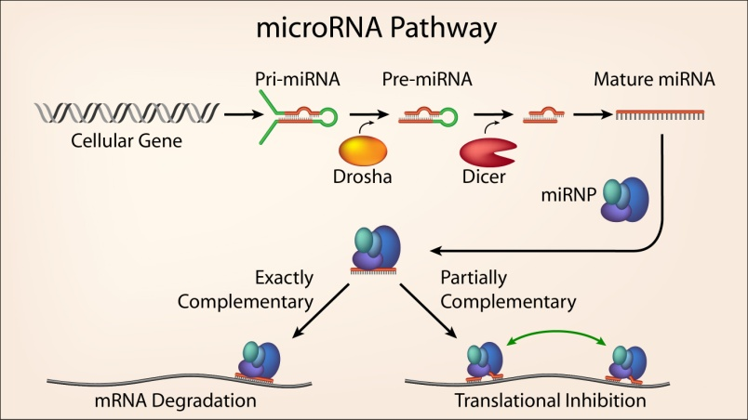
Provider of Global Contract Research Services Accelerating Preclinical Research, Drug Discovery & Therapeutics
Services > RNAi Screening and Analysis
Altogen Labs RNA Interference Services
Altogen Labs carries years of experience performing RNAi screening and data analysis
We offer a complete set of RNAi services to meet the every need that your project calls for
miRNA Pathway
http://web.mit.edu/sharplab
Contact us to discuss details, timeline estimates, and price quotes!
Altogen Labs • 11200 Manchaca Road #203 • Austin • TX • 78748 • USA
Telephone • 512 433 6177 • email • info@altogenlabs.com

