Slide 1
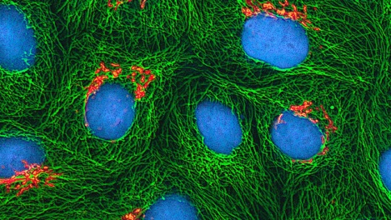
Provider of Global Contract Research Services Accelerating Preclinical Research, Drug Discovery & Therapeutics
Services > Generation of Stable Cell Lines
Transfected genetic material can be expressed in the target cells either transiently or permanently depending on the methods utilized and the experimental questions being investigated. Stable transfected cell lines are developed in order to analyze the long-term impact of altered gene or protein expression.
Altogen Labs provides services for the following type of cell lines:
Reporter stable cell lines (luciferase, GFP, RFP, YFP) Protein overexpressing cell lines
Knockdown (RNAi) cell lines
Tetracycline-inducible cell lines
GFP-expressing HeLa cells
src: tumblr.com
Altogen Labs • 11200 Manchaca Road #203 • Austin • TX • 78748 • USA
Telephone • 512 433 6177 • email • info@altogenlabs.com

Slide 2
Provider of Global Contract Research Services Accelerating Preclinical Research, Drug Discovery & Therapeutics
Services > Generation of Stable Cell Lines
Types of Transfection
Transfected genetic material can be expressed in the target cells either transiently or permanently depending on the methods utilized and the experimental questions being investigated.
Transient transfection is used most commonly to analyze the short-term impact of altered gene or protein expression. Plasmid DNA (pDNA), messenger RNA (mRNA), short interfering RNA (siRNA), and microRNA (miRNA), are introduced and gene products are expressed in the target cells however the nucleic acids do not integrate into the host cell genome. Therefore, gene product expression is transient and typically results in high expression levels that persist for 24-72 hours when RNA is transfected, or 48-96 hours following DNA transfection.
Conversely, stable transfected cell lines are developed in order to analyze the long-term impact of altered gene or protein expression. In a subpopulation of transfected cells, the transfected genetic material will integrate into the genome. In order to create stable cell lines, the gene of interest along with a selectable marker is introduced in to the cell. The growth of transfected cells, in the presence of a selecting agent, will enable the subpopulation of cells in which the exogenous genetic material has been incorporated into the genome to persist while the remaining cells undergo selection.
Altogen Labs • 11200 Manchaca Road #203 • Austin • TX • 78748 • USA
Telephone • 512 433 6177 • email • info@altogenlabs.com

Slide 3
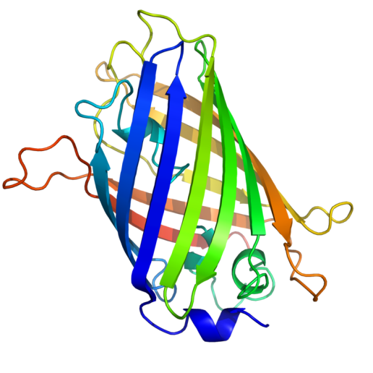
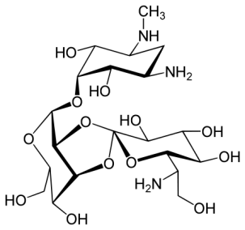
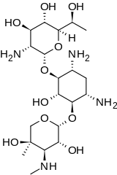
Provider of Global Contract Research Services Accelerating Preclinical Research, Drug Discovery & Therapeutics
Services > Generation of Stable Cell Lines
Stable Cell Line Selection
Typically, antibiotic resistance or fluorescent reporter gene markers are incorporated into the plasmid DNA construct to facilitate selection process. These selection markers can be co-expressed on the same vector or independently expressed on two separate vectors. The selection process facilitates the selection of the most efficient expressers or silencers of the gene of interest.
For example, Geneticin, also known as G418 sulfate, is commonly used for the selection of mammalian, plant, or yeast cells. Hygromycin B is an aminoglycosidic antibiotic that can inhibit protein synthesis by disrupting translocation and promoting mistranslation of the 80S ribosome. Hygromycin B can be utilized in dual-selection experiments since its mode of action is different from Geneticin.
Green-fluorescent protein
Hygromycin B
G418
Altogen Labs • 11200 Manchaca Road #203 • Austin • TX • 78748 • USA
Telephone • 512 433 6177 • email • info@altogenlabs.com

Slide 4
Provider of Global Contract Research Services Accelerating Preclinical Research, Drug Discovery & Therapeutics
Services > Generation of Stable Cell Lines
Stable Cell Line Work Flow
Clonal selection in appropriate selection controls (antibiotics or fluorescence tag)
Colony pick up for monoclonal cell line development
Transfection (10-20µg plasmid/cell line)
Stable cell line generation
Gene cloning (if DNA plasmid not provided by the client)
Expression and stability check (at least 10 passages)
To generate stable cell line
Service completed in 28 days
Delivery of the cell line on dry ice and DNA plasmid (if cloning was requested).
Validation of construct expression by qRT-PCR and/or Western blot analysis
Altogen Labs • 11200 Manchaca Road #203 • Austin • TX • 78748 • USA
Telephone • 512 433 6177 • email • info@altogenlabs.com

Slide 5
Provider of Global Contract Research Services Accelerating Preclinical Research, Drug Discovery & Therapeutics
Services > Generation of Stable Cell Lines
Mammalian Stable Cell Line Development
Hybridoma mammalian cell lines→ hybrid cells produced from the fusion of normal cells with myeloma tumor cells
Characteristics:
Constitutively produce specific antibodies from the primary lymphocytes
Immortalization
Mammalian post-translational modification and protein folding that are crucial in the production of antibodies, recombinant proteins, viral-subunit proteins, and vectors for gene therapy
Non-hybridoma stable cell lines may be produced with integrated plasmids in the genome that also produce gene-specific over-expression of desired proteins.
Importance→ Gene therapy, new compound screening and therapeutic drug research
Altogen Labs • 11200 Manchaca Road #203 • Austin • TX • 78748 • USA
Telephone • 512 433 6177 • email • info@altogenlabs.com

Slide 6
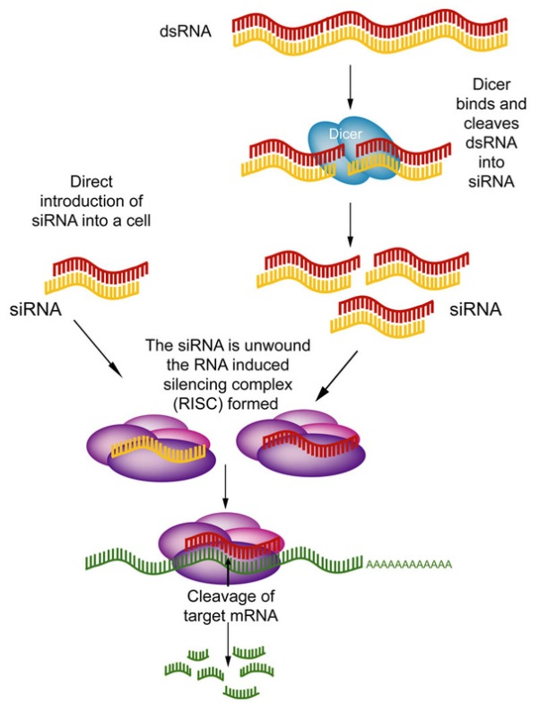
Provider of Global Contract Research Services Accelerating Preclinical Research, Drug Discovery & Therapeutics
Services > Generation of Stable Cell Lines
Stable RNAi Cell Line Generation
The mechanism of RNAi is based on the sequence-specific degradation of host mRNA through the cytoplasmic delivery of double-stranded RNA (dsRNA which are typically 21-28 nucleotides in length) identical to the target sequence.
Targeted gene silencing is achieved by the transfection of small interfering RNA (siRNA), which are bound by the RISC complex used as guides for destruction of the mRNA containing the complementary sequence. RNAi induced gene silencing can be achieved by stable engineering of a cell line expressing the siRNA.
RNAi expressing cell lines allow for functional studies of genes, gene target discovery, validation of gene targets, assay development, and screening of drug compounds.
Challenges: very laborious (extensive use of controls such as the efficiency of gene silencing, controlling for off-target effects, and promoter compatibility), expensive, and time-consuming
Gene Silencing via RNA Interference
Altogen Labs • 11200 Manchaca Road #203 • Austin • TX • 78748 • USA
Telephone • 512 433 6177 • email • info@altogenlabs.com

Slide 7
Provider of Global Contract Research Services Accelerating Preclinical Research, Drug Discovery & Therapeutics
Services > Generation of Stable Cell Lines
Tetracycline Inducible Cell Lines
RNAi gene knockdown experiments using transient/stable over-expression are not viable when manipulations of gene expression result in cell growth/proliferation defects or unwanted cell differentiation.
Consequently, researchers have adapted the Tetracycline repressor protein (TetR), taken from E. coli, to generate very efficient and tight regulatory systems to express cDNAs in mammalian cells.
TetR has been modified to either
Block initiation of transcription by binding to the Tet-operator (TO) in the promoter region upon addition of tetracycline (termed Tet-off system)
or
Bind to the TO in the absence of tetracycline (termed Tet-on system).
The Tet-off system requires the continuous presence of tetracycline (which has a half-life of about 24 hr in tissue cell culture medium). Hence the Tet-on system has been more extensively optimized, resulting in the development of very tight and efficient regulation of expression.
Altogen Labs • 11200 Manchaca Road #203 • Austin • TX • 78748 • USA
Telephone • 512 433 6177 • email • info@altogenlabs.com

Slide 8
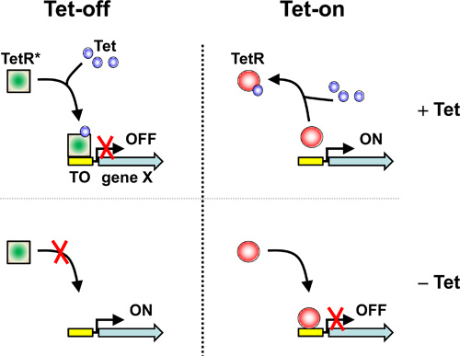
Provider of Global Contract Research Services Accelerating Preclinical Research, Drug Discovery & Therapeutics
Services > Generation of Stable Cell Lines
Tetracycline Inducible Cell Lines
Source: Gomez-Martinez et al., 2013
Altogen Labs • 11200 Manchaca Road #203 • Austin • TX • 78748 • USA
Telephone • 512 433 6177 • email • info@altogenlabs.com

Slide 9
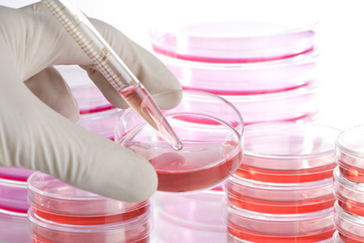
Provider of Global Contract Research Services Accelerating Preclinical Research, Drug Discovery & Therapeutics
Services > Generation of Stable Cell Lines
Stable Cell Line Services
In-house cell lines built on the Tet On/Off system
More than 150 cancer cell lines available
Highly efficient gene delivery technologies
We have extensive cell culture experience and expertise, as well as specific optimized protocols for efficient cell line generation
Customizable reporter gene expression systems
Cost effective and time managed delivery (Duration:28 Days)
We have optimized our stable cell services to be delivered in 28 days.
Altogen Labs • 11200 Manchaca Road #203 • Austin • TX • 78748 • USA
Telephone • 512 433 6177 • email • info@altogenlabs.com

Slide 10
Provider of Global Contract Research Services Accelerating Preclinical Research, Drug Discovery & Therapeutics
Services > Generation of Stable Cell Lines
Preclinical and Biology Contract Research Services
In addition to cell line development services, Altogen Labs provides following preclinical research services:
Cell banking
RNA interference services
Cell-based assay development and antibody production
Vector construction, cloning and recombinant construct expression
Xenograft animal services
Pharmacology and toxicology studies
Altogen Labs offers a full spectrum of pre-clinical research services in a GLP-compliant environment.
100% Intellectual Property rights belong to the client.
Altogen Labs • 11200 Manchaca Road #203 • Austin • TX • 78748 • USA
Telephone • 512 433 6177 • email • info@altogenlabs.com

