Slide 1
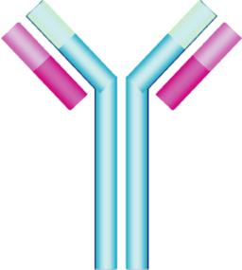
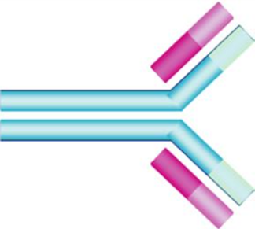
Provider of Global Contract Research Services Accelerating Preclinical Research, Drug Discovery & Therapeutics
Services > Enzyme-Linked Immunosorbent Assay
ELISA is a plate-based assay technique designed for detecting and quantifying substances such as peptides, proteins, antibodies and hormones.
The substance’s binding activity is measured as a spectrophotometric response and quantified against a specifically constructed standard curve.
Altogen Labs • 11200 Manchaca Road #203 • Austin • TX • 78748 • USA
Telephone • 512 433 6177 • email • info@altogenlabs.com

Slide 2
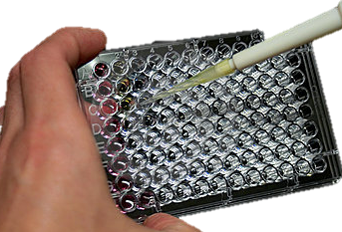
Provider of Global Contract Research Services Accelerating Preclinical Research, Drug Discovery & Therapeutics
Services > Enzyme-Linked Immunosorbent Assay
Principles
ELISAs are typically performed in polystyrene plates which will passively bind a known antibody or protein within the wells of the plates. This is know as the solid phase
Altogen Labs • 11200 Manchaca Road #203 • Austin • TX • 78748 • USA
Telephone • 512 433 6177 • email • info@altogenlabs.com

Slide 3
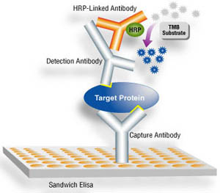
Provider of Global Contract Research Services Accelerating Preclinical Research, Drug Discovery & Therapeutics
Services > Enzyme-Linked Immunosorbent Assay
The plate is flooded with a liquid sample and a process of incubation and washes removes any unbound antigens or substrates from the wells.
Any substrate that has bound to the solid phase will remain.
The plate is flooded with a final liquid of antibodies or proteins carrying detection enzyme, or other tags, which detects any bound component, thus indicating its presence.
Altogen Labs • 11200 Manchaca Road #203 • Austin • TX • 78748 • USA
Telephone • 512 433 6177 • email • info@altogenlabs.com

Slide 4
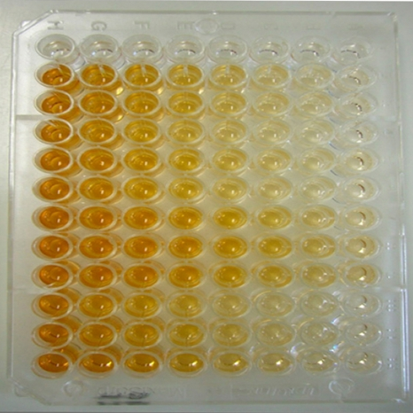
Provider of Global Contract Research Services Accelerating Preclinical Research, Drug Discovery & Therapeutics
Services > Enzyme-Linked Immunosorbent Assay
This reaction causes a colorimetric change visible in each well, and the intensity is measured via spectrophotometry and calculated to give a concentration.
More bound substrates=more bound detection enzymes=more colorimetric reactions
Altogen Labs • 11200 Manchaca Road #203 • Austin • TX • 78748 • USA
Telephone • 512 433 6177 • email • info@altogenlabs.com

Slide 5
Provider of Global Contract Research Services Accelerating Preclinical Research, Drug Discovery & Therapeutics
Services > Enzyme-Linked Immunosorbent Assay
Purpose
ELISAs can be used to quantify the presence of a protein through its binding activity.
Customizable monoclonal and polyclonal antibodies make the ELISA a very versatile assay able to detect most targets of interest, with high affinity, specificity and sensitivity.
Altogen Labs (www.AltogenLabs.com) offers:
• Antibody Testing, Custom labeling, Biotinylation, Purification • Monoclonal and Polyclonal Antibody Development • ELISA Assay Development • ELISA Platform Optimization • ELISA Assay Format Modification
Altogen Labs • 11200 Manchaca Road #203 • Austin • TX • 78748 • USA
Telephone • 512 433 6177 • email • info@altogenlabs.com

Slide 6
Provider of Global Contract Research Services Accelerating Preclinical Research, Drug Discovery & Therapeutics
Services > Enzyme-Linked Immunosorbent Assay
Types of ELISA Assays
Direct ELISA
Indirect ELISA
Sandwich ELISA
Competitive ELISA
Altogen Labs • 11200 Manchaca Road #203 • Austin • TX • 78748 • USA
Telephone • 512 433 6177 • email • info@altogenlabs.com

Slide 7
Provider of Global Contract Research Services Accelerating Preclinical Research, Drug Discovery & Therapeutics
Services > Enzyme-Linked Immunosorbent Assay
Type: Indirect ELISA
The antigen to be tested is diluted with a carbonate buffer, often PBS, and the PVC wells in an ELISA plate are filled and incubated over night.
The wells are washed and any unbound antigen removed.
A blocking buffer blocks any protein-binding sites in the now coated wells to reduce false-positive reactions.
Add the primary antibody diluted to the optimal concentration with blocking buffer.
Incubate and wash with the carbonate buffer used in step one.
Dispense the enzyme-linked secondary antibody into each well and incubate.
Add a stop solution to stop the detection substrate’s reaction and read the optical density (OD) of each well.
Against the prepared standard curve, calculate the concentration of each well.
Altogen Labs • 11200 Manchaca Road #203 • Austin • TX • 78748 • USA
Telephone • 512 433 6177 • email • info@altogenlabs.com

Slide 8
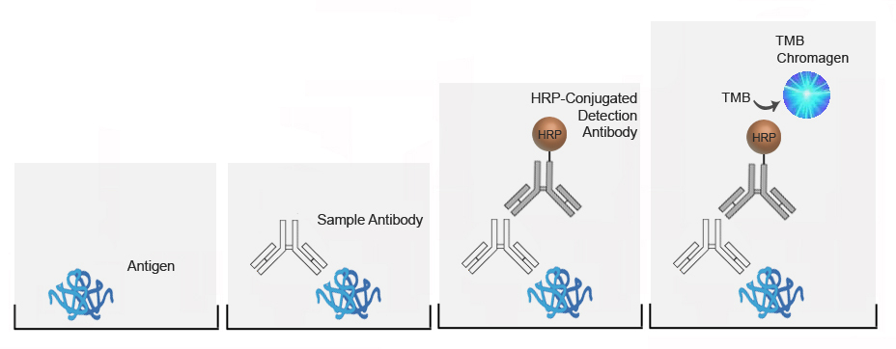
Provider of Global Contract Research Services Accelerating Preclinical Research, Drug Discovery & Therapeutics
Services > Enzyme-Linked Immunosorbent Assay
Antigen adheres to well and unbound antigen is removed
Antibody is added and binds to any available antigen
Detection substrate is added and binds to the sample antibody
The detection antibody reacts if bound and produces a color change
Altogen Labs • 11200 Manchaca Road #203 • Austin • TX • 78748 • USA
Telephone • 512 433 6177 • email • info@altogenlabs.com

Slide 9
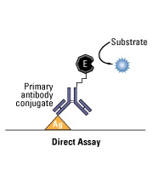
Provider of Global Contract Research Services Accelerating Preclinical Research, Drug Discovery & Therapeutics
Services > Enzyme-Linked Immunosorbent Assay
Type: Direct ELISA
Similar to the indirect ELISA, the antigen must be incubated in a buffer solution in the ELISA plate’s wells overnight and all unbound antigen removed.
The primary antibody is already conjugated with an enzyme tag and is added to each well and incubated and washed to remove any unbound enzyme-conjugated-antibody.
Once the enzyme substrate is added, the bound enzyme-conjugated-antibodies will cause a colorimetric reaction indicating the quantity of antigen present.
Altogen Labs • 11200 Manchaca Road #203 • Austin • TX • 78748 • USA
Telephone • 512 433 6177 • email • info@altogenlabs.com

Slide 10
Provider of Global Contract Research Services Accelerating Preclinical Research, Drug Discovery & Therapeutics
Services > Enzyme-Linked Immunosorbent Assay
Type: Sandwich ELISA
A known concentration of antibodies are incubated overnight in the wells.
Any unbound antibody is washed using a buffer solution, and a blocking buffer is added to block any non-specific binding sites on the surface.
The wells are washed and the antigen sample is added to the plate.
The wells are washed so that unbound antigen is removed.
A specific antibody is added, and it binds to antigen followed by another series of washes to remove unbound antibody.
The enzyme-linked secondary antibodies are added and bind to the antibody's Fc region (non-specific) and the plate is washed so that the unbound antibody-enzyme conjugates are removed.
The substrate for the enzyme-conjugated antibody is added and the plates are incubated to allow color development.
The stop solution is added. The OD is measured and the concentration is determined from a previously determined standard curve.
Altogen Labs • 11200 Manchaca Road #203 • Austin • TX • 78748 • USA
Telephone • 512 433 6177 • email • info@altogenlabs.com

Slide 11
Provider of Global Contract Research Services Accelerating Preclinical Research, Drug Discovery & Therapeutics
Services > Enzyme-Linked Immunosorbent Assay
The known antibody is attached to the well’s surface and adheres the target antigen. The primary antibody is added and binds to another binding site of the antigen creating a ‘sandwich’ effect.
The enzyme-linked secondary antibody binds to the non-specific region of the primary antibody and causes a color change when the substrate is added, correlating to the quantity of bound antigen.
Altogen Labs • 11200 Manchaca Road #203 • Austin • TX • 78748 • USA
Telephone • 512 433 6177 • email • info@altogenlabs.com

Slide 12
Provider of Global Contract Research Services Accelerating Preclinical Research, Drug Discovery & Therapeutics
Services > Enzyme-Linked Immunosorbent Assay
Type: Competitive ELISA
The ELISA plate is coated with the capture antibody, incubated over night and all unbound antibodies are removed through a series of washes
A blocking buffer is added to block any potential binding sites on the plates surface
An enzyme-conjugated version of the protein of interest is added to the plates as well as the test sample.
All unbound proteins are removed through a series of washes leaving enzyme-conjugated proteins and any proteins of interest in the test sample bound to the antibodies.
The substrate is added and allowed to develop before adding a stop solution.
More target protein in the sample=less enzyme conjugated protein binding=less substrate reaction and less color change
Altogen Labs • 11200 Manchaca Road #203 • Austin • TX • 78748 • USA
Telephone • 512 433 6177 • email • info@altogenlabs.com

Slide 13
Provider of Global Contract Research Services Accelerating Preclinical Research, Drug Discovery & Therapeutics
Services > Enzyme-Linked Immunosorbent Assay
Advantages:
ELISAs are generally more accurate, considered highly sensitive and specific compared to other immunoassays such as radioimmune assays
ELISAs are safer as they don’t need radioisotopes or expensive radiation counters to measure binding activity.
The high sensitivity of ELISAS means it can detect levels of target proteins at nanogram levels.
The use of antibody-antigen binding in ELISAs makes it a highly specific test, binding only to target epitopes relevant to the study.
Disadvantages:
ELISAs are a time sensitive assay and require appropriate incubation for accurate results; incubating too long or too short a time could lead to too much color development or too little binding activity.
All steps of the assay are important, and, if done manually, washes must be thorough in order to not leave any loose antibody or antigen in the well.
For optimal results, antibodies may need to be engineered, tested and samples may need to go through purification steps before being useable.
Altogen Labs • 11200 Manchaca Road #203 • Austin • TX • 78748 • USA
Telephone • 512 433 6177 • email • info@altogenlabs.com

Slide 14
Provider of Global Contract Research Services Accelerating Preclinical Research, Drug Discovery & Therapeutics
Services > Enzyme-Linked Immunosorbent Assay
Customizable monoclonal and polyclonal antibodies produce high affinity, specificity and sensitivity to immune- and cell- based assays to identify given target antigens.
Altogen Labs can use a robust cell-based ELISA assay to analyze customer-provided samples. Standard ELISA service include testing activity of the compound of interest on a panel of 15 intracellular Ser/Thr kinases and 17 Tyr kinases, using phospho-specific antibodies by the determination of substrate-specific phosphorylation activity induced by kinase activation.
CUSTOM SERVICES:
• Antibody Labeling, Biotinylation, Purification • Monoclonal Antibody Development • ELISA: Assay Development • ELISA: Platform Optimization • ELISA: Assay Format Modification
Altogen Labs • 11200 Manchaca Road #203 • Austin • TX • 78748 • USA
Telephone • 512 433 6177 • email • info@altogenlabs.com

